Slide 1
Chapter 10: Managing Permissions and Shares
Instructor-led overview and operational guidance

Slide 2
Learning Objectives
01 Explain the key administrative ideas in Chapter 10
02 Identify the relevant Windows Server tools, workflows, and decision points
03 Relate the topic set to real operational and security practices
04 Prepare for later hands-on administration and troubleshooting work
Windows Server 2025 | Chapter 10 | Managing Permissions and Shares
02

Slide 3
Chapter Topics
01 10.1 Permissions
02 10.2 Shares
03 10.3 Offline Files
04 10.4 Volume Shadow Copies
05 10.5 Introduction to Group Policy
Windows Server 2025 | Chapter 10 | Managing Permissions and Shares
03

Slide 4
10.1 Permissions
Permissions determine who can access resources and what actions they can perform.
Access control entries and ACLs
Identity-based authorization
Inheritance and effective access
Windows Server 2025 | Chapter 10 | Managing Permissions and Shares
04

Slide 5
NTFS ACL Permissions
Every securable object has a security descriptor containing a DACL and a SACL of ACEs.
ACL types
DACL: identifies trustees allowed or denied access
SACL: defines auditing (success/failure events)
No DACL = full access to all; empty DACL = all access denied
Standard permissions
Full Control, Modify, Read & Execute
List Folder Contents (folders only)
Read, Write
Advanced: Take Ownership, Change Permissions, Traverse Folder, Delete Subfolders and Files, etc.
Inheritance flags
OI (Object Inherit): files inherit the ACE
CI (Container Inherit): subfolders inherit the ACE
NP: do not propagate beyond direct children
Block: icacls /inheritance:d (disable) or :r (remove)
Precedence (highest first)
Explicit Deny
Explicit Allow
Inherited Deny
Inherited Allow
Explicit Allow overrides Inherited Deny.
Windows Server 2025 | Chapter 10 | Managing Permissions and Shares
10

Slide 6
SMB Share Permissions
Share permissions gate network access to a share — they never apply to local logons.
The three permission levels
Read — view names, open files, run executables
Change — Read + create, modify, delete
Full Control — Change + modify share ACL, take ownership
How they differ from NTFS
Coarse (3 rights vs ~14 granular NTFS rights)
Stored on the share object, not the file system
No inheritance model, no auditing/SACL
Defaults & ABE
New shares default to Everyone = Read (since Server 2003)
Access-Based Enumeration hides items a user cannot access
ABE filters listings but doesn't enforce access — NTFS still does
PowerShell cmdlets
New-SmbShare -Name X -Path C:\Data -FullAccess … -ChangeAccess …
Grant-SmbShareAccess -Name X -AccountName Y -AccessRight Change
Set-SmbShare -Name X -FolderEnumerationMode AccessBased
Get-SmbShareAccess -Name X
Windows Server 2025 | Chapter 10 | Managing Permissions and Shares
10

Slide 7
Effective Access: NTFS + SMB Combined
For network access, the more restrictive of share and NTFS wins.
Combination rule
Effective = intersection (most restrictive) of Share ∩ NTFS
Share Full Control + NTFS Read → Read
Share Read + NTFS Modify → Read
Local access ignores share permissions — only NTFS applies
Group membership
Allow ACEs from all groups are cumulative (union)
Net effective = (∪ Allows) − (∪ Denies)
Effective Access tool (GUI)
Properties > Security > Advanced > Effective Access tab
Select a user or group → View effective access
Supports device claims for Dynamic Access Control
Command-line
icacls "C:\Data" — view DACL
icacls "C:\Data" /grant "DOMAIN\U:(OI)(CI)M" /T
Get-Acl C:\Data | Format-List
$acl.AddAccessRule($rule); Set-Acl …
Get-Acl -Audit — returns the SACL
Windows Server 2025 | Chapter 10 | Managing Permissions and Shares
10

Slide 8
10.2 Shares
Shares expose folders across the network so users and systems can access files through SMB.
SMB share objects
Share permissions and paths
Network-based access model
Windows Server 2025 | Chapter 10 | Managing Permissions and Shares
05

Slide 9
Access-Based Enumeration (ABE)
ABE filters the contents of an SMB share so users see only the folders and files their NTFS permissions allow — they cannot see content they cannot open.
Server-side filtering of directory listings
Driven entirely by NTFS permissions on underlying folders
Available on any SMB share on Windows Server 2025
Disabled by default — must be enabled per share
Windows Server 2025 | Chapter 10 | Managing Permissions and Shares
06

Slide 10
How ABE Works
When a user opens a share, ABE intercepts the directory listing and removes any items the user cannot read — before the list leaves the server.
1
User Opens
Share
2
Server Lists
All Items
3
ABE Checks
NTFS ACL per Item
4
Filtered List
Returned to User
Key: ABE relies entirely on NTFS permissions — no separate visibility list to manage. Configure NTFS permissions correctly first, then enable ABE.
Performance consideration: ABE evaluates the ACL of every item in the directory at enumeration time. On shares with thousands of items, this can increase server CPU load and slow the listing.
Windows Server 2025 | Chapter 10 | Managing Permissions and Shares
07

Slide 11
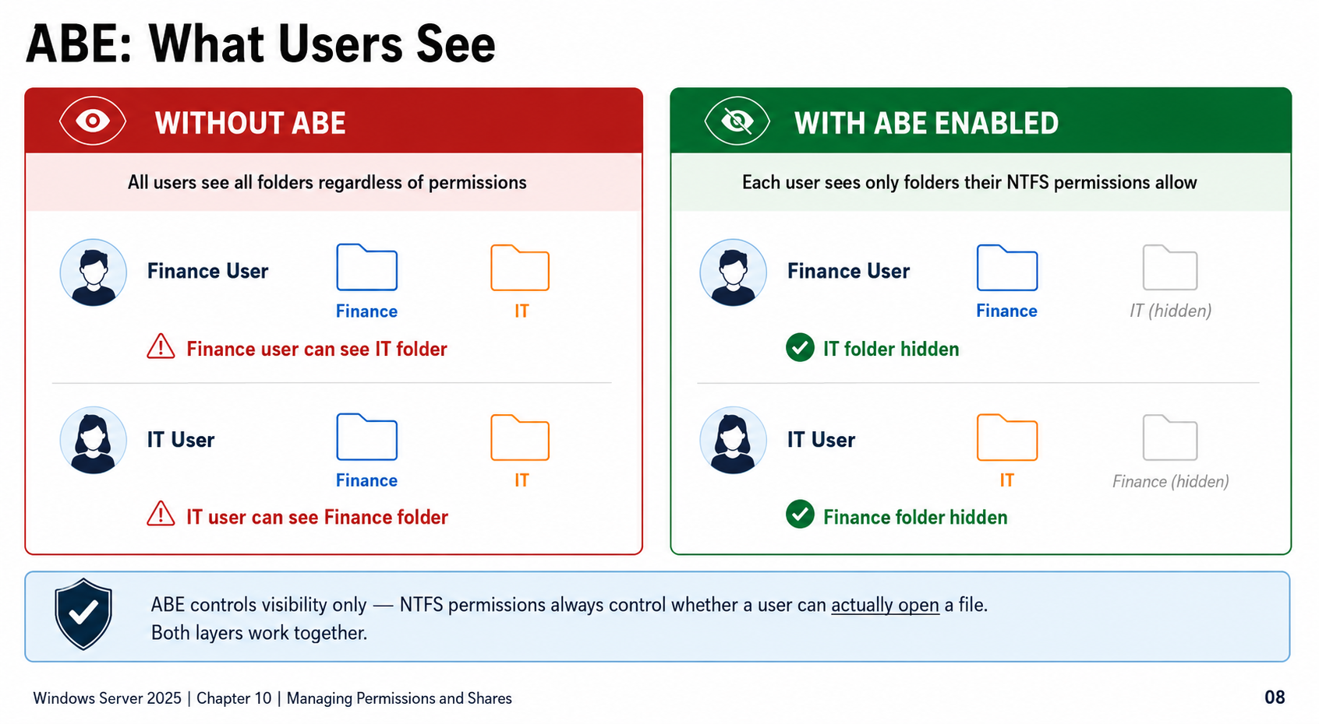

Slide 12
Enabling Access-Based Enumeration
Server Manager (GUI)
PowerShell
# Enable ABE on a new share
New-SmbShare -Name DeptData \
-Path C:\DeptData \
-FolderEnumerationMode AccessBased
# Enable ABE on an existing share
Set-SmbShare -Name DeptData \
-FolderEnumerationMode AccessBased
# Verify ABE setting
Get-SmbShare DeptData |
Select Name, FolderEnumerationMode
1. Open Server Manager
2. File and Storage Services
then Shares
3. Select the share
then Tasks then Properties
4. Select the Settings tab
5. Check Enable access-based
enumeration
6. Click OK
Administrative Focus
Enable per share via Server Manager or PowerShell. Verify with FolderEnumerationMode: AccessBased.
Windows Server 2025 | Chapter 10 | Managing Permissions and Shares
09

Slide 13
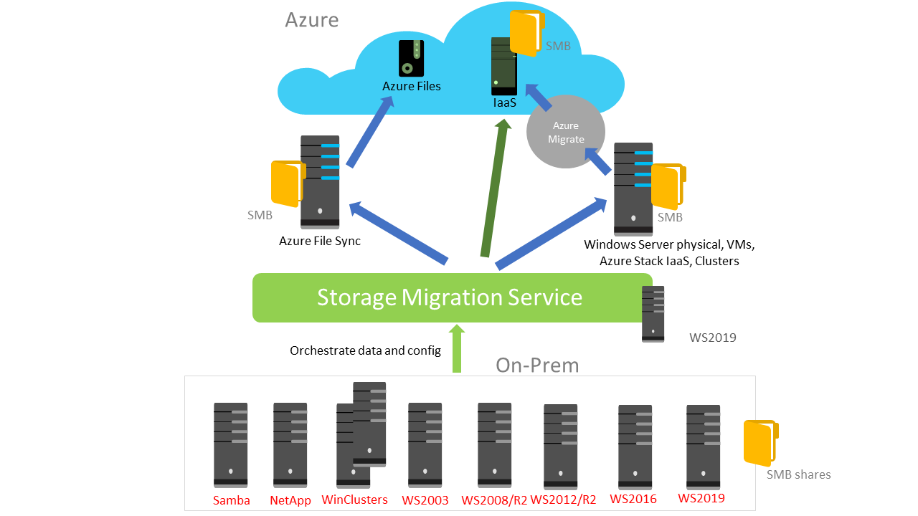
10.3 Storage Migration Service
Migrate file servers and shares to modern Windows Server or Azure while preserving user access paths.
What it does
• Inventories Windows, Linux Samba and NetApp CIFS file servers
• Transfers files, file shares and security configuration
• Optionally cuts over the server identity to the destination
• Managed from Windows Admin Center for one or many migrations
Key idea: users and apps can keep using existing paths after cutover
The service orchestrates the migration; it does not remove source files.
Source: Microsoft Learn — Storage Migration Service overview
Windows Server 2025 | Chapter 10 | Managing Permissions and Shares

Slide 14
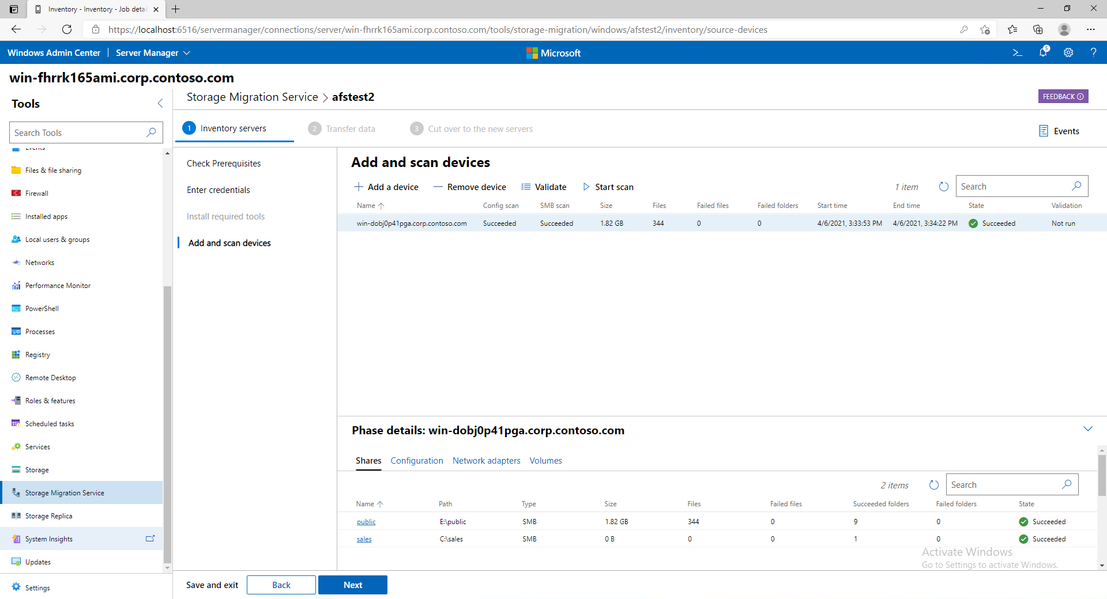

Slide 15
How the Migration Process Works
Storage Migration Service uses a predictable inventory, transfer, cutover workflow.
1
Inventory
2
Transfer
3
Cut over
Scan source servers
Collect files, shares, volumes, local users/groups and security settings
Copy data to destination
Preserve share and NTFS configuration; repeat copies can reduce final downtime
Optional identity switch
Destination assumes source name/network identity so paths remain unchanged
After cutover, the source server enters a maintenance state and remains available for decommissioning later; source files are not deleted by the service.
For a migration without identity cutover, update DFS, mapped drives, application paths or user shortcuts separately.
Source: Microsoft Learn — Storage Migration Service overview
Windows Server 2025 | Chapter 10 | Managing Permissions and Shares

Slide 16
Storage Migration Service Architecture
Windows Admin Center drives the migration, while an orchestrator coordinates source and destination servers.
Source File Server
Windows Admin Center UI
Orchestrator Server
Destination Server / Cluster / Azure VM
Runs SMS UI extension
Coordinates inventory, transfer and cutover
Core requirements
• Orchestrator: Windows Server 2019 or later
• Destination: Windows Server 2019+ recommended; standalone or failover cluster
• Migration accounts: admin on source, destination and orchestrator
• Firewall: SMB-In, Netlogon NP-In, WMI DCOM-In and WMI-In
Windows, Linux Samba, NetApp CIFS, clusters
Source: Microsoft Learn — Storage Migration Service overview
Windows Server 2025 | Chapter 10 | Managing Permissions and Shares

Slide 17
Operational Planning and Azure Options
Use Storage Migration Service for file-server migrations; use Azure Migrate for lift-and-shift VM moves.
Plan the file-server migration
Azure migration paths
• Decide whether the destination will take over the source server identity
• Validate DNS, AD domain membership and SPNs before cutover
• Schedule cutover for the shortest acceptable outage window
• Keep the source server for rollback/decommission checks
• Re-run transfer to reduce delta data before final cutover
• Windows Admin Center can deploy an Azure IaaS VM for the destination
• It can configure storage, join the VM to the domain and install roles
• Azure Files is not a direct SMS destination
• Servers running Azure File Sync with cloud tiering are supported
• Azure Migrate is the better tool for moving whole VMs unchanged
Migration decision: data and shares = Storage Migration Service | whole server workload = Azure Migrate
Source: Microsoft Learn — Storage Migration Service overview
Windows Server 2025 | Chapter 10 | Managing Permissions and Shares

Slide 18
10.3 Offline Files
Offline Files supports client-side caching of network files for availability during disconnected use.
Client-side caching
Sync behavior and policies
Workload suitability
Windows Server 2025 | Chapter 10 | Managing Permissions and Shares
10

Slide 19
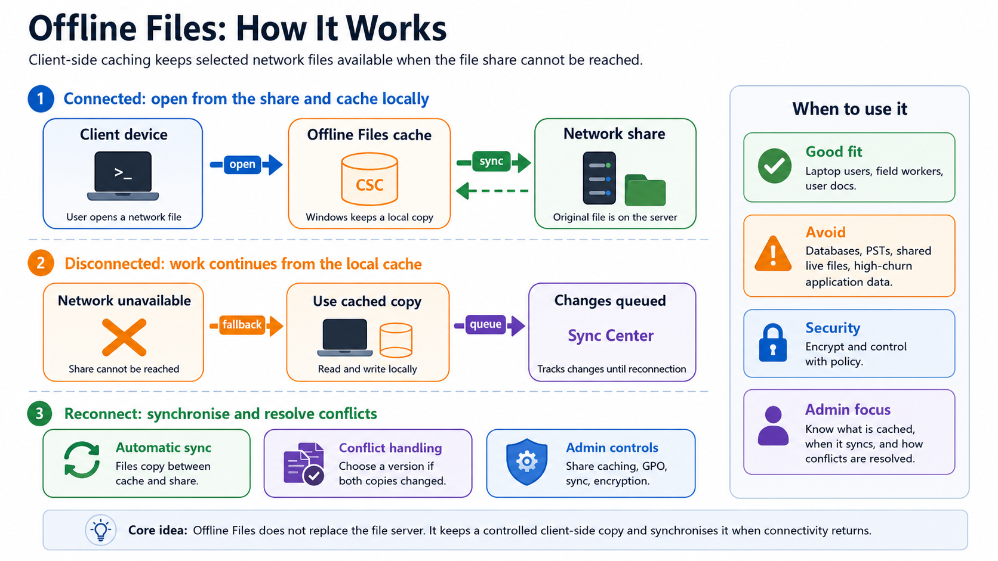

Slide 20
10.4 Volume Shadow Copies
Volume Shadow Copies provide point-in-time copies that support recovery and previous version access.
Snapshot-style copies
Storage overhead considerations
Recovery and user self-service value
Windows Server 2025 | Chapter 10 | Managing Permissions and Shares
11

Slide 21
10.4 Shadow Copies of Shared Folders
VSS-based, point-in-time, read-only versions of shared files on NTFS/ReFS volumes.
Requirements
NTFS or ReFS volume with an assigned drive letter (avoid mount points)
Source volume must host a share; clusters require a file share resource via Cluster Administrator
Maximum supported volume size: 64 TB (VSS unsupported above this)
Configuration (Computer Management)
Right-click My Computer > Manage > Shared Folders
All Tasks > Configure Shadow Copies
Select the source volume, click Settings, pick the storage destination
Set a maximum size (or No limit), click OK > Enable
Limits and defaults
64 shadow copies per volume retained (oldest deleted when reached)
512 software shadow copies per volume overall (VSS ceiling)
Default storage area: 10% of volume size; minimum 300 MB
Default schedule: 7:00 AM and 12:00 noon, weekdays only
VSS writer freeze ~60s; provider snapshot generation ~10s
Best practices
Place the storage area on a separate physical disk for performance
Never schedule more than once per hour; align with user work patterns
Treat as a recovery aid — not a replacement for regular backups
Caveat: snapshots are volume-scoped and read-only; resizing the storage association can drop existing copies.
Windows Server 2025 | Chapter 10 | Managing Permissions and Shares
10

Slide 22
10.6 GPOs and File Shares
Group Policy provides four key controls for file share environments:
1 Drive Mapping (User Configuration > Preferences > Drive Maps)
Automatically maps network shares to drive letters at logon using Item-Level Targeting
Target by AD security group, OU, or user — e.g. map \\server\Finance only to Finance group members
2 Network Shares (Computer Configuration > Preferences > Network Shares)
Create, modify, or delete shared folders on servers centrally; includes ABE (Access-Based Enumeration) options
3 File System Permissions (Computer Configuration > Security Settings > File System)
Deploy NTFS permissions to folders across servers without touching each machine individually
4 SMB Signing (Computer Configuration > Security Settings > Security Options)
Enforce data integrity on all SMB connections — prevents tampering and relay attacks in transit
Key Principle
GPO Preferences are suggestions — users can override them. GPO Policies are enforced — users cannot.
Windows Server 2025 | Chapter 10 | Managing Permissions and Shares
12

Slide 23
Chapter Summary
01 Differentiate NTFS permissions, share permissions, and policy-driven behavior
02 Show how file access works in managed business environments
03 Connect sharing concepts to identity, policy, and recovery capabilities
04 Reinforce repeatable administration, validation, and supportable design choices
Windows Server 2025 | Chapter 10 | Managing Permissions and Shares
14

Slide 24
Knowledge Check
1
What is the main administrative purpose of Permissions?
2
What is the main administrative purpose of Shares?
3
What is the main administrative purpose of Offline Files?
4
What is the main administrative purpose of Volume Shadow Copies?
Windows Server 2025 | Chapter 10 | Managing Permissions and Shares
15

Slide 25
PRACTICE LAB
Lab 1001
Creating File Shares and Managing Share Permissions
In this lab, you will create shared folders on your Windows Server and configure share permissions. You will learn the difference between NTFS permissions and share permissions, and how they work together to control access.
Windows Server 2025 | Chapter 10 | Managing Permissions and Shares
16

